Slide 1



Advanced Cooling Technologies
Reduce Energy Cost
Reduce Moisture
Eliminate System Icing
CoolSaver uses surface chemistry catalytic reactions to eliminate moisture from your air conditioning and chill room systems.
Powerful - Effective - Economical
CoolSaver is easy to install, easy to maintain and will continue to deliver results for up to 10 years

Slide 2

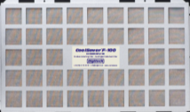
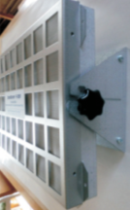
A Unique Technology
Developed and manufactured in Sweden, CoolSaver is the only system to use surface chemistry catalytic reactions to extract moisture from industrial and commercial cooling systems
The technology and chemistry is very complex but the equipment is easy to install, easy to maintain and exceptionally effective in removing moisture
By removing moisture, CoolSaver improves cooling efficiency with resulting energy savings of between 15% and 50% depending on the application and ambient climatic conditions
Removing moisture and condensate leads to additional benefits of…
No icing, this safer working conditions, and improved system efficiency and temperature control
Eliminates mold and mildew
Improves conditions for food and perishable storage
No more cooling and ducting space flooding in air conditioning systems
Advanced Cooling Technologies
Where CoolSaver is Used
CoolSaver is a market proven technology with installations still performing as good as new up to 10 years later
Our customers’ applications for this technology include
Restaurant and Hotel chill rooms for food storage
Hospital and laboratory cold rooms
Central Air conditioning systems
Free standing refrigerators
Refrigerated trucking and containers
Commercial chilled distribution centres

Slide 3
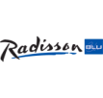




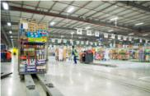

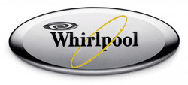


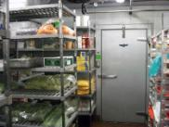

Our Customers
McDonalds Restaurants
Viking Cruise Lines
ICA (retail groups)
COOP (retail group)
Whirlpool / Indesit Refrigerators
National Petrol Station Chain
Meridien Hotel
Sheraton Hotel
Radisson Hotel
E-on
International Pharmaceutical Companies
Refrigerated Distribution Operator
Advanced Cooling Technologies
Can it Be Fitted To An Existing System
CoolSaver is a compact device which can be easily fitted to an existing system.
It is attached to the input of the evaporator and ‘treats’ the air before it enters the system
CoolSaver Engineers will assess your site and recommend the optimal sizing and installation method and train your staff on routine maintenance procedures.
NO expensive consumables are required for its maintenance
CoolSaver is available under lease or rental agreements, delivering instant cash positive benefits and savings straight to your bottom line, from the very first day!
We take care of the CAPEX, you take the OPEX SAVINGS

Slide 4
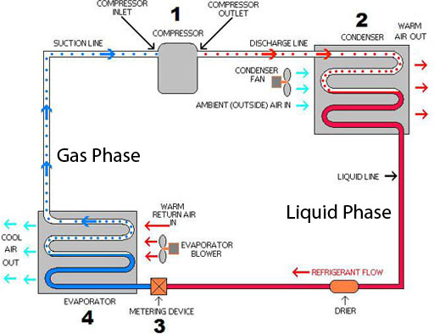

Advanced Cooling Technologies
panels
EVAPORATOR BLOWER
WARM RETURN AIR IN

Slide 5
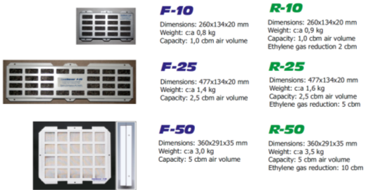
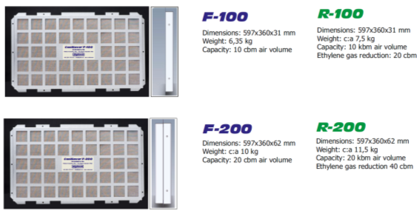
Humidity Control Catalytic Panels
Advanced Cooling Technologies

Slide 6
Advanced Cooling Technologies Ltd
How It Works
AC systems are designed to remove a certain amount of moisture at peak conditions. This is known as the latent heat ratio of the system.
Sensible heat is the heat measured in degrees on a common thermometer.
Latent heat is the heat in terms of moisture removed.
A building's air conditioning removes moisture from the air in order to provide for both human comfort and mold-and-mildew control. Warm moist air is blown through a cooling coil to cool the air below its dew point temperature.
The dew point temperature is defined as the temperature of the air when the relative humidity is 100 percent. Relative humidity is defined as the amount of moisture in the air relative to the most moisture the air can hold at the same temperature.
As air is cooled it loses its ability to hold moisture. So, relative humidity is increased by cooling the air, as well as by adding moisture to it. For example, as the air cools on a muggy night the relative humidity increases. When the relative humidity reaches 100%, the air has been cooled to its dew point and dew forms on surfaces. Similarly for the air conditioner, once the air is cooled below the dew point, the air releases moisture which collects in a drain pan, and drains out of the system. The cooled and dried air is delivered to the building. The air now has a lower dew point called the exit dew point. Many air conditioning systems do not remove adequate amounts of moisture for a tropical climate.
At peak conditions there is more sensible heat than latent heat.
At night and on cooler days, the amount of sensible heat shrinks but the amount of latent heat does not. And, on wet days, the amount of latent heat increases.
During humid and/or cool weather, standard AC systems cool the buildings, but they dont dehumidify adequately.
Furthermore, some new air conditioning units have sacrificed latent (moisture removal) capacity in order to increase their nameplate SEER ratings. (SEER stands for Seasonal Energy Efficiency Ratio and is a measure of energy efficiency.) One way manufacturers increase SEER is to raise the cooling coil temperature. Unfortunately, this means that the air blown through the coil does not reach a low dew point temperature. Some of these high efficiency units have a latent heat ratio of 15 percent or less at design conditions.
Cont/d….

Slide 7
Advanced Cooling Technologies Ltd
How It Works
cont/d…
CoolSaver® AC Moisture Control
REMOVES Latent Heat:
improving the thermal performance of the air conditioner
STOPS Condensation:
Eliminating slippery, hazardous working conditions
REDUCES Humidity
Protecting against unsightly corrosion of expensive furnishings and equipment
Mold & Mildew
Relative Humidity of 50% to 70 % and higher provide the ideal environment for the formation of mold spores and mildew. By reducing the moisture content in your building, CoolSaver® AC Moisture Control will provide your business with safer, healthier air and a climate free of moisture-borne allergens, mold and mildew.
Better Indoor Air Quality
Excess moisture is the cause of microbial growth, pollution, mold and even "Sick Building Syndrome." The key to controlling these problems is to control moisture.
Energy Conservation
CoolSaver® AC Moisture Control saves electricity in two ways.
Air conditioning systems (especially the high efficiency ones) cycle on and off so quickly that little moisture is removed from the air. With CoolSaver dry air is being fed into the system. The system would therefore not cycle on and off as often, thus reducing energy consumption.
When excess moisture is removed from the air, the air feels cooler. As a result, the thermostat may be changed to a higher temperatures setting for the same cooling effect. For every degree you raise the thermostat, you save 7 % on energy costs.
1
2

Slide 8

Catalytic Panels
Surface Chemistry Explanation
The surface chemical process is a molecular catalytic process of ion exchange. The surface chemistry is based on the fact that the bonding forces of a solid are arranged differently on the surface than on the inside of an object.
Ions are therefore absorbed at a different rate, a characteristic which is exploited by CoolSaver for the purification and separation of gases and liquids. The oxygen and hydrogen atoms in the air normally form gaseous water which, in connection with changes in temperature from high to low temperature, thereby creates moisture in the form of condensed water. What happens in the CoolSaver Catalytic Panels is a molecular “sieving” of the air, where the individual gaseous water molecules, through contact with the minerals in the CoolSaver® Catalytic Panels, are prevented from linking together and switching aggregation states, in this case from gas to condensate.
The process is analogous to what happens within catalytic converters for car exhausts.
MAINTENANCE
CoolSaver works entirely on a surface chemistry catalytic process. The material within the panels is highly complex and presents a massive surface area of between 500square metres and 1,000 square meters per gram to the air passing through the panel. This enormous surface area provides for a very high rate of catalytic reaction to the gasses passing across its surface.
In this respect it is unlike other ‘anhydrous/deliquescing’ filter materials which simply absorb moisture from the air and therefore need to be dried or regenerated frequently to discharge the accumulated moisture. The catalytic process prevents moisture forming or “aggregating” at a molecular level. However, the catalytic process does itself generate very small amounts of moisture which over extended periods will begin to cover the internal surface areas of the catalytic material with ice particles. This is removed periodically by removing the panels and drying them under sun or a heated blower. Typically the planned maintenance cycle would be once every 3 to 4 months per panel and does not require any special equipment, chemicals or technical expertise.
The production of ice particles on the catalytic surfaces generally only occurs on panels fitted to chill rooms and refrigerators operating at sub-zero temperatures. For air conditioning applications operating above zero degrees the requirement for planned maintenance drying is generally unnecessary or can be reduced to say once every 6 to 12 months.
The performance claims for
CoolSaver Catalytic Panels
have been independently verified by
SP Swedish National Testing and Research Institute in Borås.

Slide 9
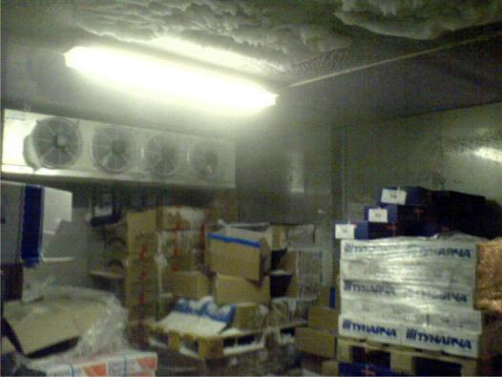
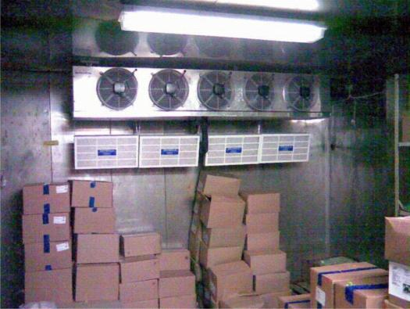
Advanced Cooling Technologies
Before
After
Refrigerated food storage area before and after CoolSaver Catalytic Panels are installed to dehumidify and remove icing from the chill room area

Slide 10
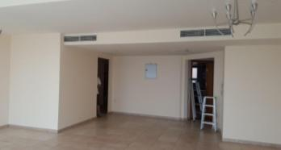
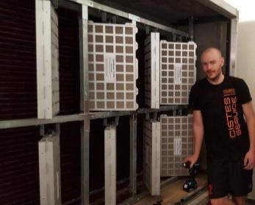
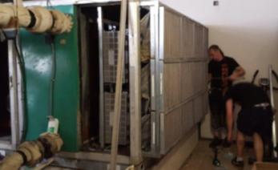
Advanced Cooling Technologies
CoolSaver Catalytic Panels installed to central, ducted air conditioning system in an apartment block in Dubai. Energy savings currently in excess of 40%

Slide 11


CoolSaver will deliver immediate savings from the first month of installation
With BeiXi Financial Solutions the equipment may be acquired on a lease or rental basis
THUS
You can enjoy immediate cash flow savings from the first month of installation, profit that goes straight to the P&L bottom line
Lease or rent over 5 years
5 Year Guarantee on all equipment supplied
Immediate net savings
Immediate energy savings
Immediate additional benefits including
Elimination of icing
Elimination of condensate from system and ducting spaces
Fresher food and improved storage in chill rooms
Reduced corrosion of furnishings and equipemt

